Slide 1
IMS Project Group A6
Giulia Baldini, Emanuela Calabi, Mikel Grabocka
29/11/2017

Slide 2
Technologies used
Bootstrap
Php
MySQL

Slide 3
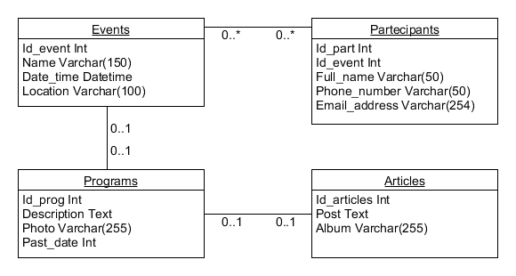
Database

Slide 4
Wireframes

Slide 5
Estimated Effort

Slide 6
A First Look at Uniscout

